Slide 1
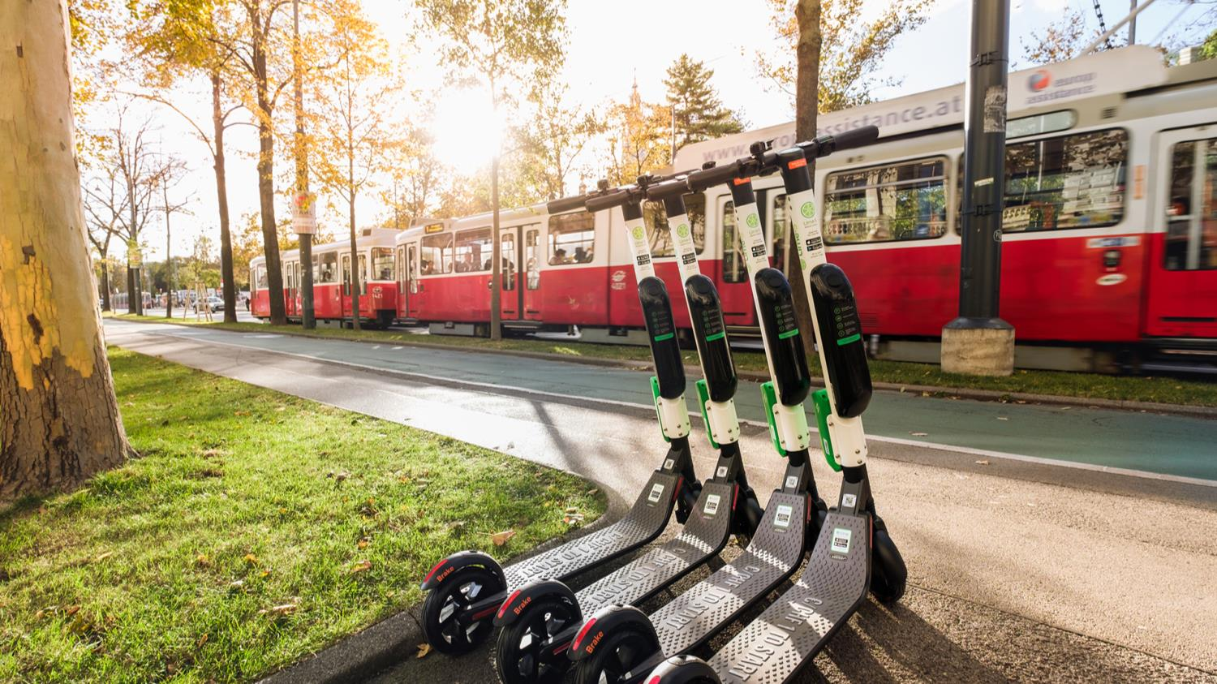

INTRODUCTION TO ICLEI’S SUSTIANABLE MOBILITY
Beatrice Ch’ng Sin Yi
Sustainable Mobility Officer
ICLEI World Secretariat

Slide 2
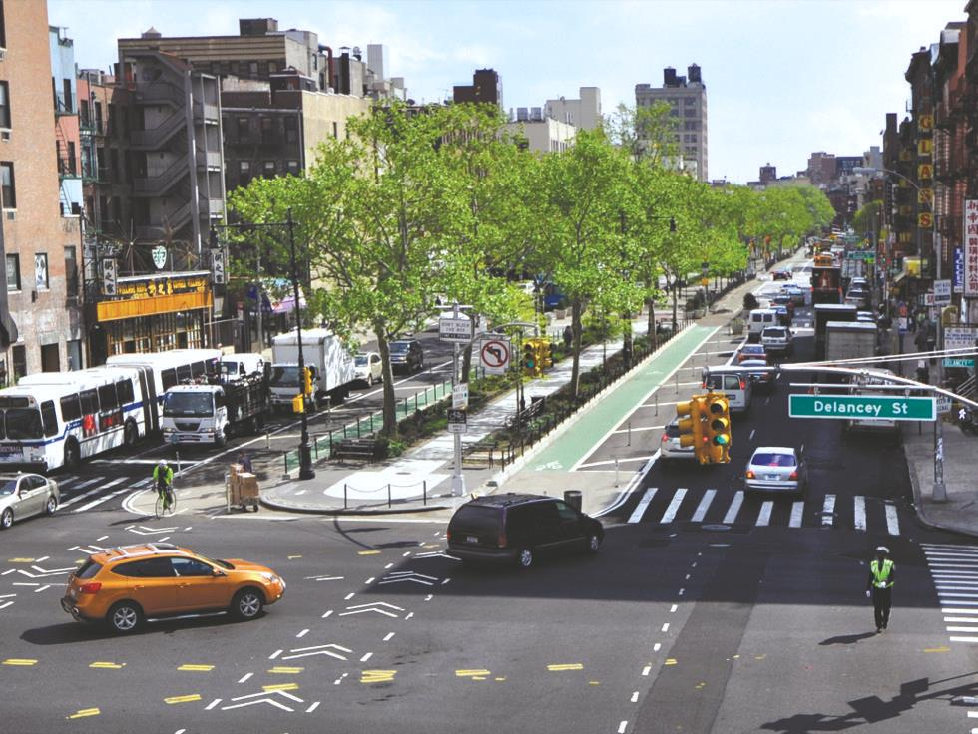
Not just about mobility!
People-centred urban development
Health
Safety
Better use of urban space
Economic benefits
Time saving
Equitable access
Low emissions
Photo: www.nacto.org

Slide 3
SUSTAINABLE MOBILITY @ ICLEI
Sustainable Mobility
EcoMobility
EcoLogistics

Slide 4

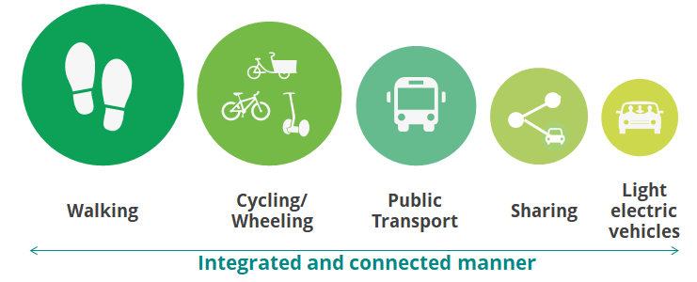

Slide 5








SUSTAINABLE MOBILITY @ ICLEI
Reducing dependency on private motorised vehicles
Sustainable Urban Mobility Plans (SUMP)
Green vehicles procurement
Mobility assessment and audits
Information repository
Sustainable mobility campaigns
Implementing innovative urban transport solutions
Action areas
Initiatives
EcoMobility SHIFT
EcoMobility Alliance
EcoMobility World Festival
EcoLogistics
Projects
TUMI Network
Cities SHIFT
EcoLogistics
5

Slide 6

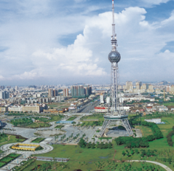


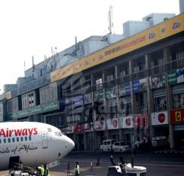
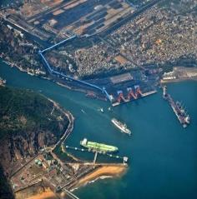
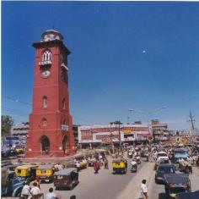
CitiesSHIFT project
The CitiesSHIFT project aims to support cities to identify challenges and opportunities of urban mobility system in hope that the city could shift towards more ecomobile modes of travel
Three intervention points:
  Performance measurement
  Capacity building
  Global dissemination
Two thematic working groups:
  Building a healthy living environnent
  Emerging mobility trends
Foshan
China
Kaili
China
Jinja
Uganda
Entebbe
Uganda
Visakhapatnam
India
Ludhiana
India
6
Notes:
It minimizes impacts on air quality, noise, health, fatalities and injuries, traffic congestion, while also reducing GHG emissions, improving livability and contributing to climate change mitigation.

Slide 7








EcoMobility SHIFT+ Scheme
(Self-)Assessment
Analyse
Act
Measure & assess performance of the entire mobility system
Conducted internally by the city
Identify strengths and weaknesses for improvement actions
External verification/ audit for benchmarking
Joint
priority-setting
Stakeholder & interdepartmental collaboration and implementation
7
Notes:
It minimizes impacts on air quality, noise, health, fatalities and injuries, traffic congestion, while also reducing GHG emissions, improving livability and contributing to climate change mitigation.

Slide 8
E1: Understanding users’ needs E2: Vision & strategy
E3: Human resources
E4: Finance
E5: Monitoring, evaluation, review
E6: Preparedness for new
mobility services
TSS 1: Walkability
TSS 2: Cycling
TSS 3: Public transport
TSS 4: Shared mobility
TSS 5: Informal mobility
TSS 6: Intermodal integration
TSS 7: Ecologistics
TSS 8: Low emission vehicles
TSS 9: Planning of city areas
TSS 10: Parking
TSS 11: Low-speed/ car-free zones
Enablers
Transport system & services
P1: Modal split
P2: Safety
P3: Local air quality
P4: Travel time
P5: GHG emissions
Performance
23 SHIFT INDICATORS

Slide 9
Modal split
Safety
Local air quality
Travel time
GHG emissions
Performance
Managing demand
Managing supply
Planning of city areas
Parking
Low-speed/ car-free zones
Transportation provision
Public transport
Shared mobility
Informal mobility
Transport system & services
User experience
Walkability
Cycling
Intermodal integration
Information services
Vehicle type
Ecologistics
Low emission vehicles
Understanding users’ needs and public participation
Vision, strategy and leadership
Human resources
Finance for ecomobility
Monitoring, evaluation, review
Preparedness for new mobility
Enablers
Notes:
Enabler: refer to what a city does and how,
TSS – what is actually delivered on the ground
Performance – refer to the achievements of the TSS that have been put in place

Slide 10


EXAMPLE OF SYDNEY, AUSTRALIA

Slide 11
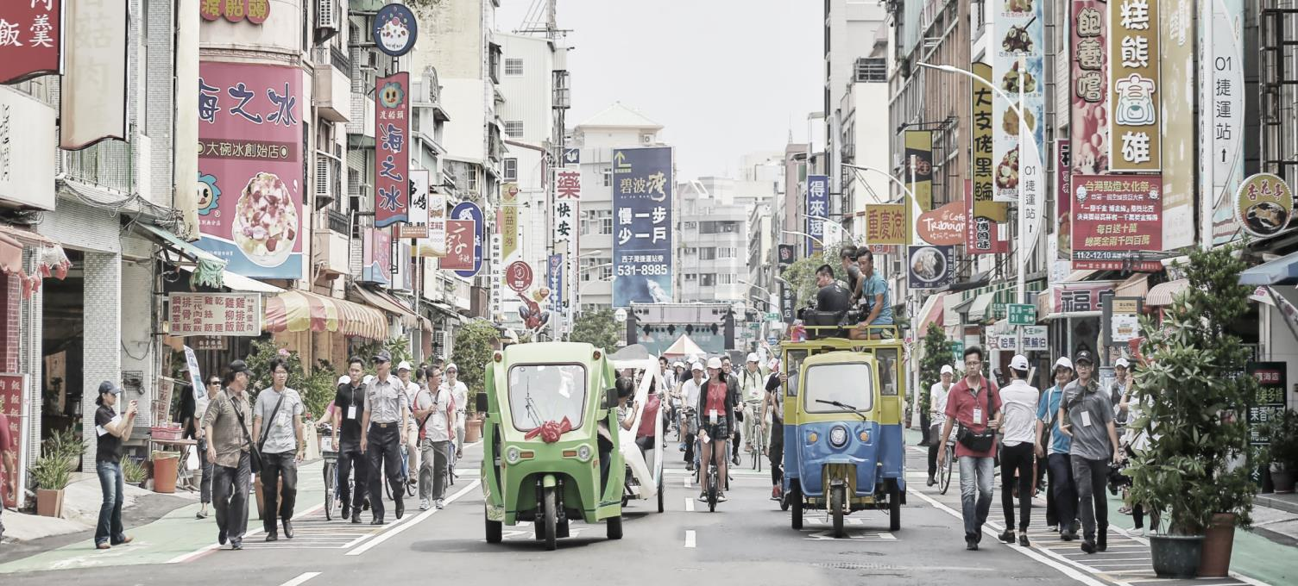






Learn more!
ecomobility@iclei.org
www.ecomobility.org/
@ecomobility_
www.facebook.com/EcoMobility.org/
ICLEI World Secretariat
Kaiser-Friedrich-Str. 7
53113 Bonn, Germany
+49 (0)228 / 976 299-50
Thank you!
Beatrice Ch’ng
ICLEI World Secretariat
Bonn, Germany
Beatrice.chng@iclei.org

